Slide 1
Parent
Guidance

Slide 3
How often?
Children need to be aiming to use TT Rockstars (any game) 3 minutes a day, 4 or 5 times a week.

Slide 4
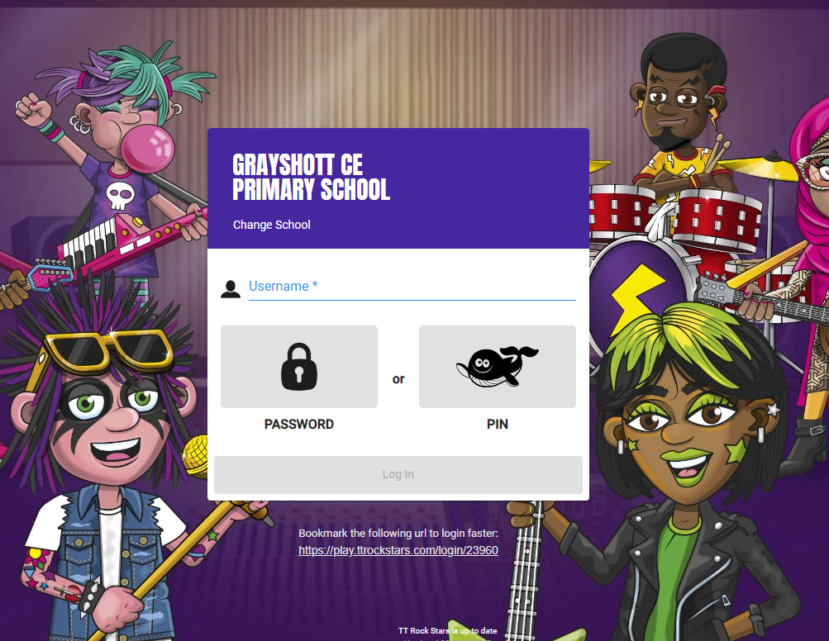
Logging in
Your child should have their user name and password.
Please speak to your class teacher or Mr Clarke if you have not got this.

Slide 5
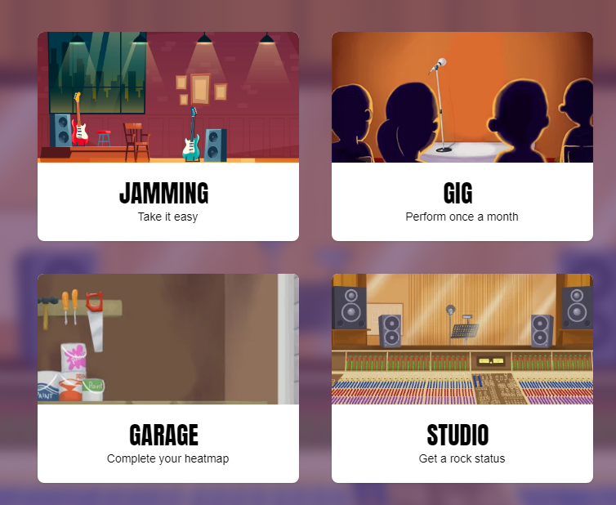
The games

Slide 6
The games

Slide 7
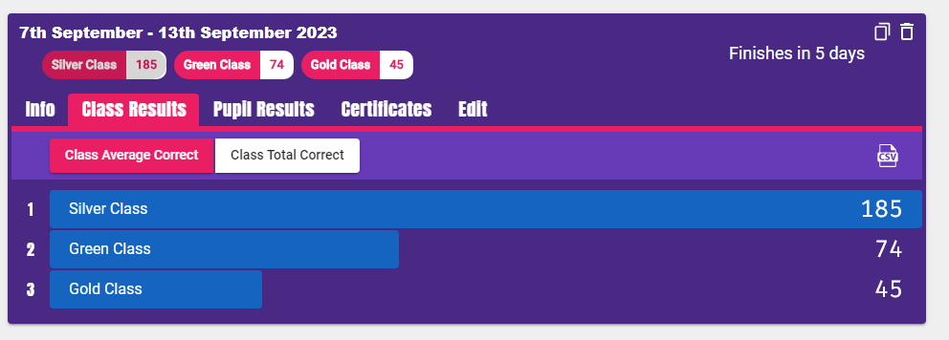
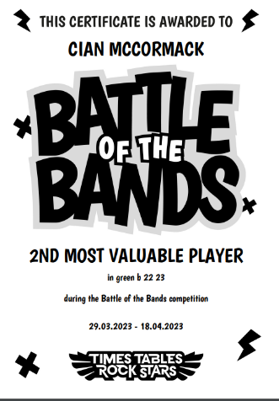
Battle of the Bands
Every week, a Battle of the Bands will be set up between Green, Silver and Gold Class
The top 3 performers from each class will get a certificate in assembly on Fridays.

Slide 8
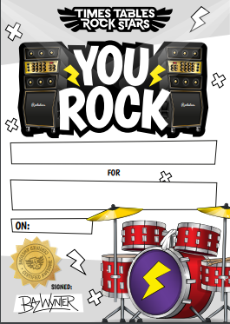
Purple Class
Every week, two children from the class will receive a certificate for:
Their effort (minutes played)
Improved fluency
Number of correct answers.

Slide 9
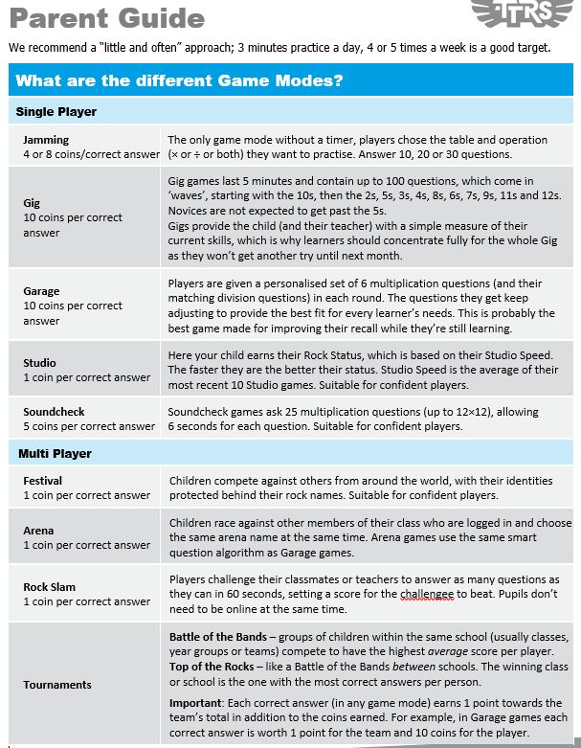
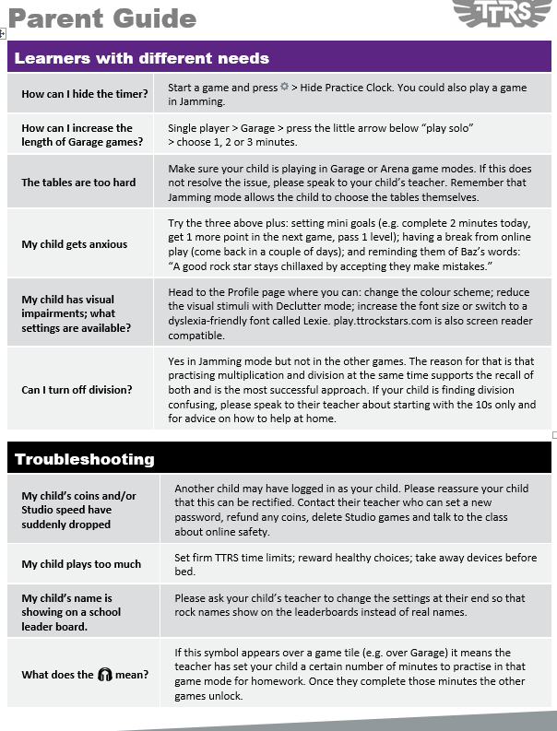
Parent Guide
Please
take one.

