Slide 1
Grayshott C of E Primary School
Love
Respect
Joy
Courage

Slide 2
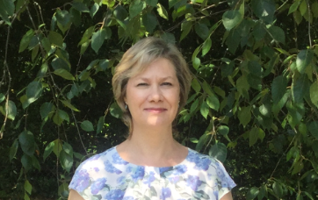
Welcome from Mrs Pritchard, Headteacher
Mr Richard Austin
Headteacher from
September 2021

Slide 3
Grayshott Church of England Primary School
‘Acorns to mighty oaks.’
Welcome to Grayshott CE Primary School, a caring and supportive village school with a Christian ethos.
As we are unable to meet your lovely children and get to know you as we normally would, we hope this information will help you know what to expect when we are able to welcome your child into school.
We understand that this is a time of uncertainty and concern. Please be assured that when we have details of the forthcoming changes and developments in regard to September, these will be relayed to you. Any decisions about transition will be made with your children’s safety and best interests at the forefront.
In the meantime, please share this PowerPoint with your child from their new class teacher!

Slide 4
Our school community
Liz Holbird, Chair of Governors
Nina Mosses, Chair of PTA
Emma and Nicky, Treetops club

Slide 5
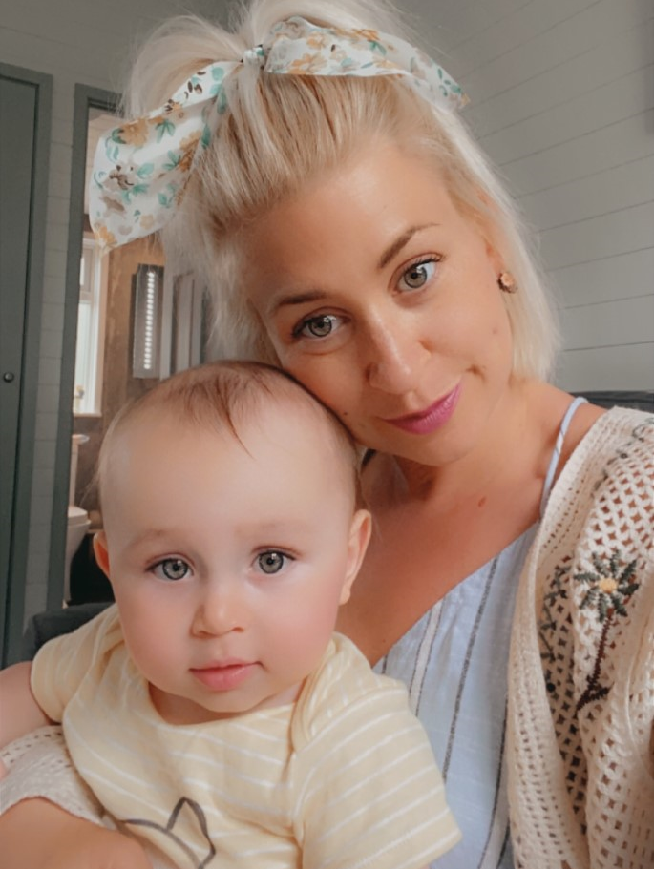
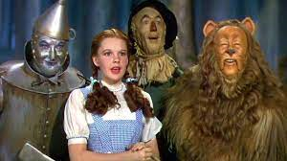
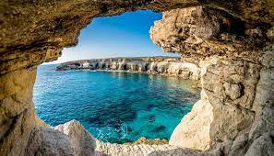
Fun Facts:
I love animals, dressing up, drama, dancing and holidays.
My favourite book is “Bad Cat” by Nicola Byrne and all Mog books by the amazing Judith Kerr (any stories involving naughty pets!) I have a cat called Betty.
I love Frozen and The Wizard of Oz.
My favourite food is…anything spicy!
I have two children who are 1 and 4 (next month.)
My family are Greek Cypriot and I miss being able to visit them. I can`t speak Greek but I can get involved with Greek dancing!
I worked in America as a Dance Teacher when I was (a lot )younger but I still love to bring dance to my teaching.
Hi everyone!
My name is Mrs Tickner and I am very excited to be teaching you in September
More about me…
I lead EYFS and KS1 at Grayshott. I have been a teacher for 12 years, working across nursery, reception, Year 1,2 and even Year 5. My passion is Children`s Books and I also lead English at Grayshott.
I believe that Reception is the most important year – we get children excited about learning and we build their confidence so that they can achieve anything they set their mind to.
I believe that all learning should have a purpose. In Red class we plan parties for the Tiger who came to tea, write recipes for mud pies, design cages to catch the colour monster and use our math skills to run a class sweet shop!

Slide 6
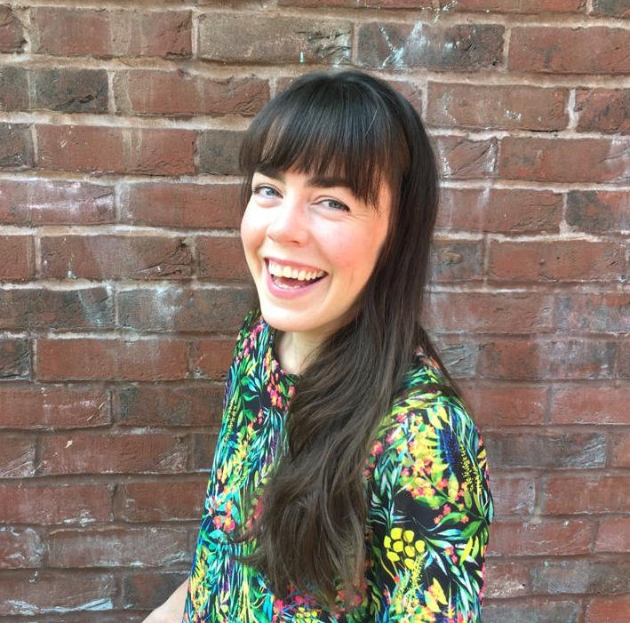
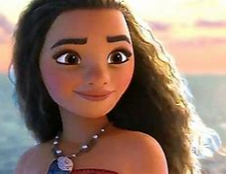
Fun Facts:
I love reading, silly voices, dancing, painting, walking in the woods and singing!
My favourite book is ‘Stuck’ by Oliver Jeffers and ‘Zog’ by the amazing Julia Donaldson.
At the moment, I am listening to lots of Moana.
‘Mater’ from Cars makes me laugh.
My favourite food is…ALL FOOD!
I have two children, 5 and nearly 3.
My family are Irish and growing up I was a national champion Irish dancer. We always have fun learning some Irish dancing on St. Patrick’s Day!
During lockdown we were lucky enough to get to the top of our local allotment waiting list. Any gardening tips are welcome.
Hello and welcome to Red Class!
My name is Mrs Benson-Breen and I’ll be your teacher next year. I can’t wait to meet you all.
More about me…
I have been a teacher for 7 years, working across nursery, reception and year 1.
I am passionate about the early years curriculum and believe that high quality play and provision enables children to learn at the highest level.
Through my role and a teacher and as a mum of two, I know that our children are often our teachers too! I look forward to learning with your child in reception and working in partnership with parents and carers.
There will also be Mrs York in Red Class who is an experienced Learning Support Assistant.

Slide 7
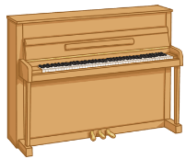
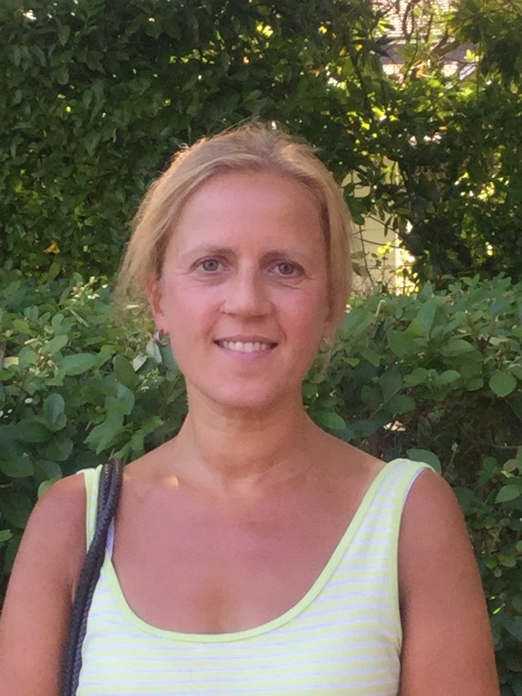
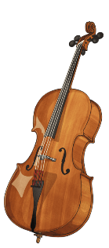
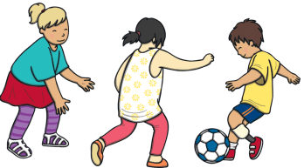
Hello Red Class!
My name is Mrs York and I will be your Learning Support Assistant.
I can’t wait to meet you all.
Fun Facts About Mrs York:
My favourite foods are: Indian, pizza…and chocolate!
I love dogs! (I’m a bit scared of snakes…)
I love to play football with my children.
I enjoy playing the piano and cello.
I love going on sunny holidays!

Slide 8
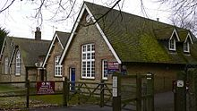
What is reception like and how do we learn?
In reception, we learn through playing and exploring. The learning will be active and available both inside and outside. All children will be encouraged and nurtured to become creative and critical thinkers.
In reception, we follow the Early Years Framework. This curriculum is different from the national curriculum and has seven areas of learning.
There are three prime areas. These are taught explicitly and underpin everything we do in reception. These are:
Personal, social and emotional development
Communication and language
Physical education
The rest of the areas of learning are known as ‘specific’. These are:
Literacy
Mathematics
Understanding the world
Expressive arts and design
We use Development Matters to help us implement the Early Years Framework.

Slide 9
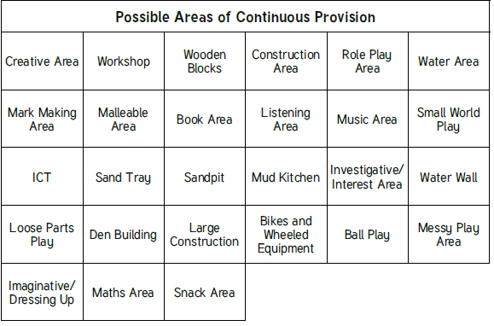
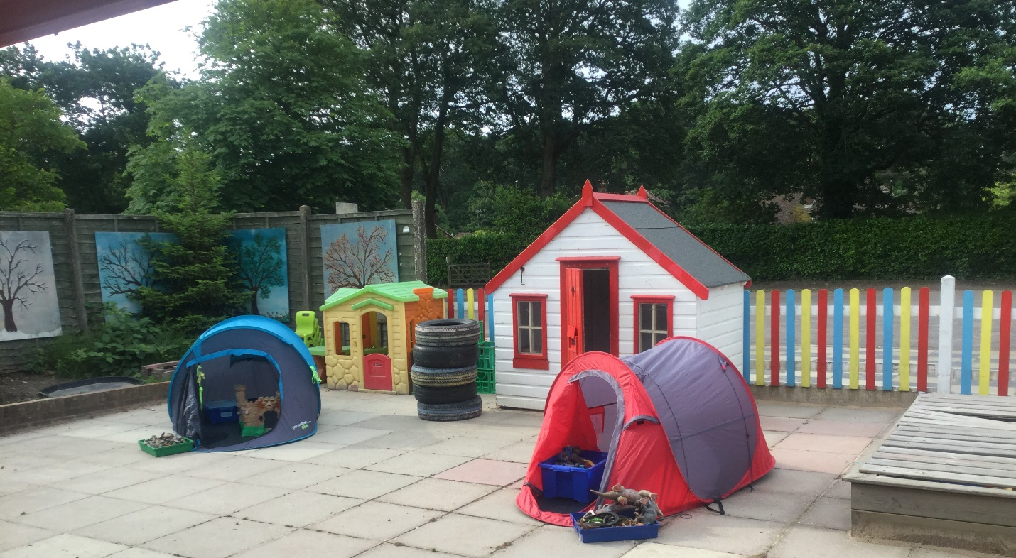
Your Classroom
Continuous provision refers to the resources that are always available inside and outside for children to access. All the resources link to what the children will be learning about each week.
Early years classrooms look different from traditional classrooms! There may be some tables and chairs but not many. Instead, children access their learning through serious play which is set out in continuous provision.
Outside…
Do you like playing outside?
I hope so! This is a picture of the outside area.
Everything that you learn inside you can learn outside too.
We have a mud kitchen as well where you can make tasty treats!

Slide 10
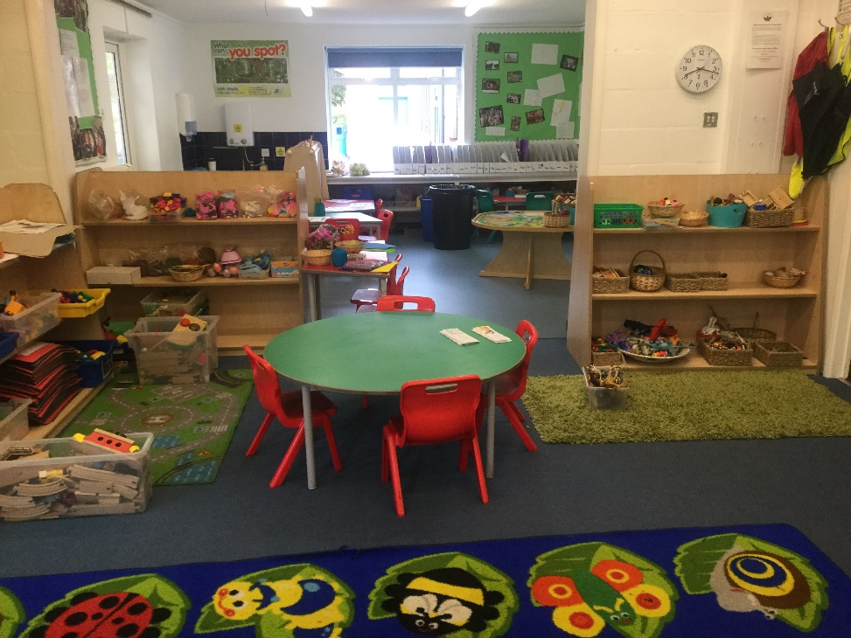
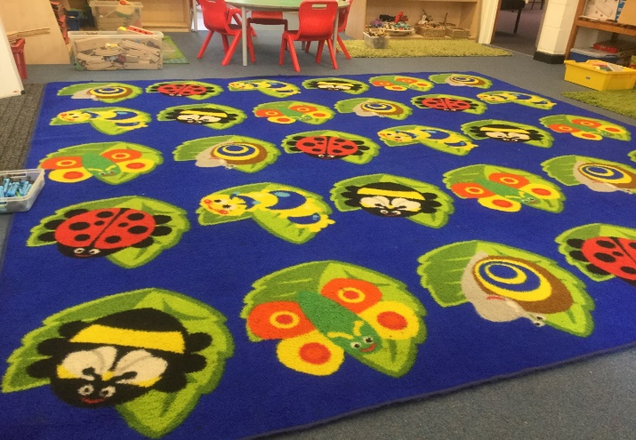
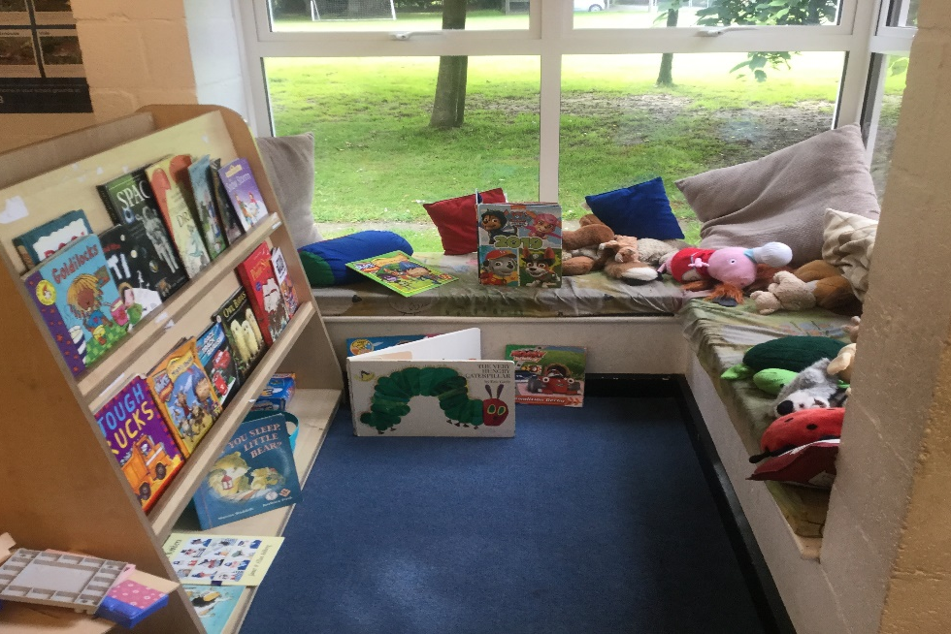
Inside…
This is our carpet area. We have two short carpet times each day. On the carpet, we sit down, do good listening, share our ideas and join in!
After carpet, you will do a special activity with Mrs Benson-Breen or Mrs York.
There will be construction and small world areas where you can build and play!
There will be cosy corners inside and outside where you can read a book or have some quiet time.

Slide 11
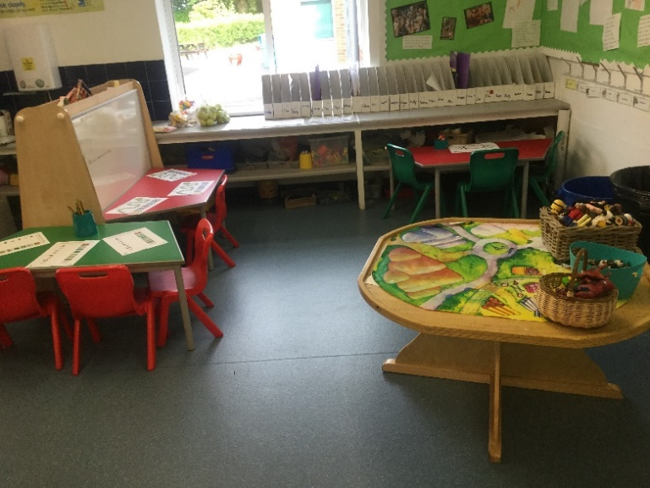
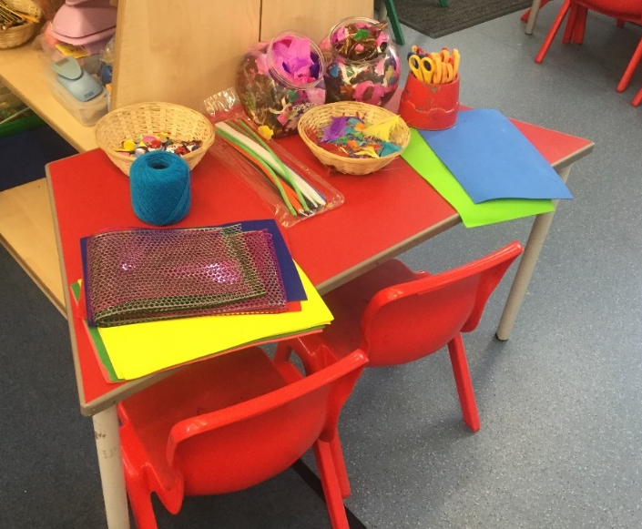
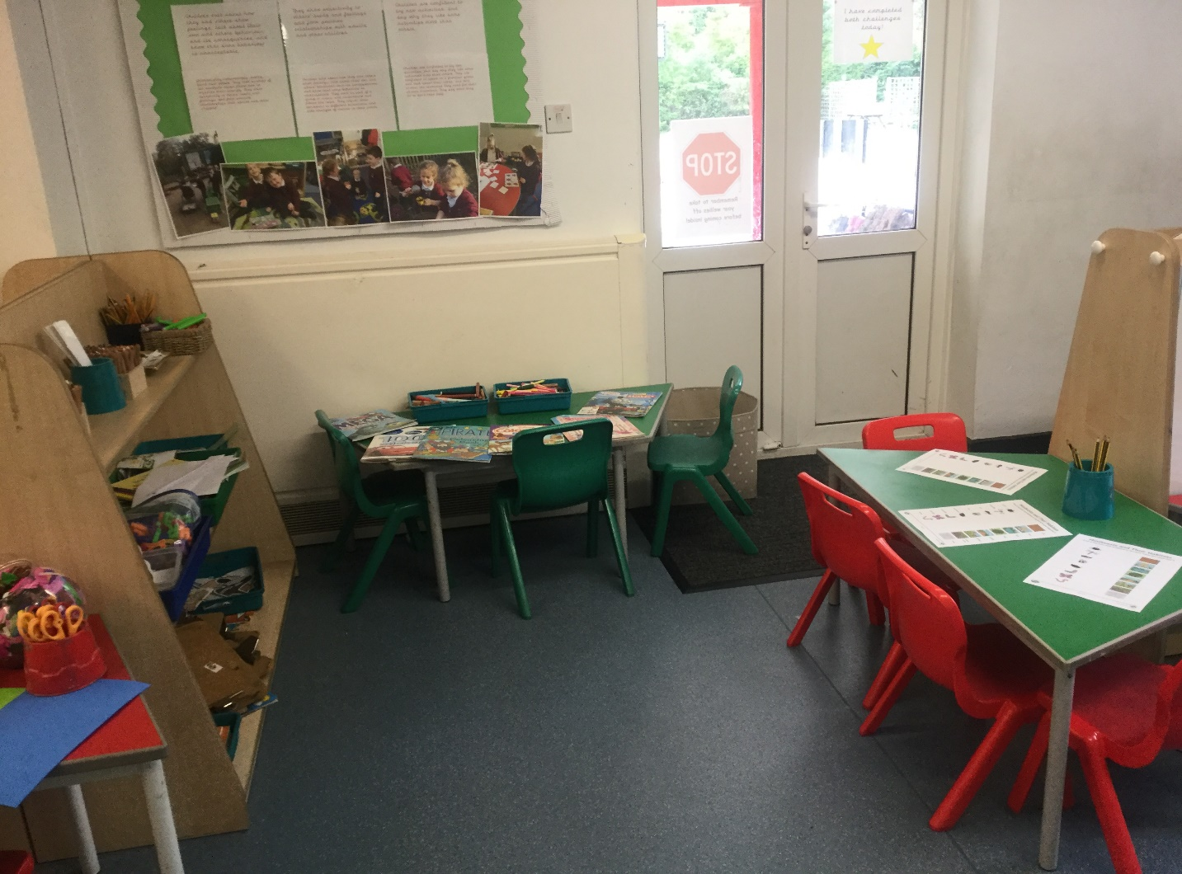
There will be fine motor activities to strengthen your hands and fingers. This will help you with your amazing mark making and writing.
There will be a writing area but you will be able to practice your writing throughout the inside and outside of the reception classroom all day.
There will be a maths area too. Here you can test out what you have learned with your friends and talk about your learning. By the end of the year, you will be maths masters!

Slide 12
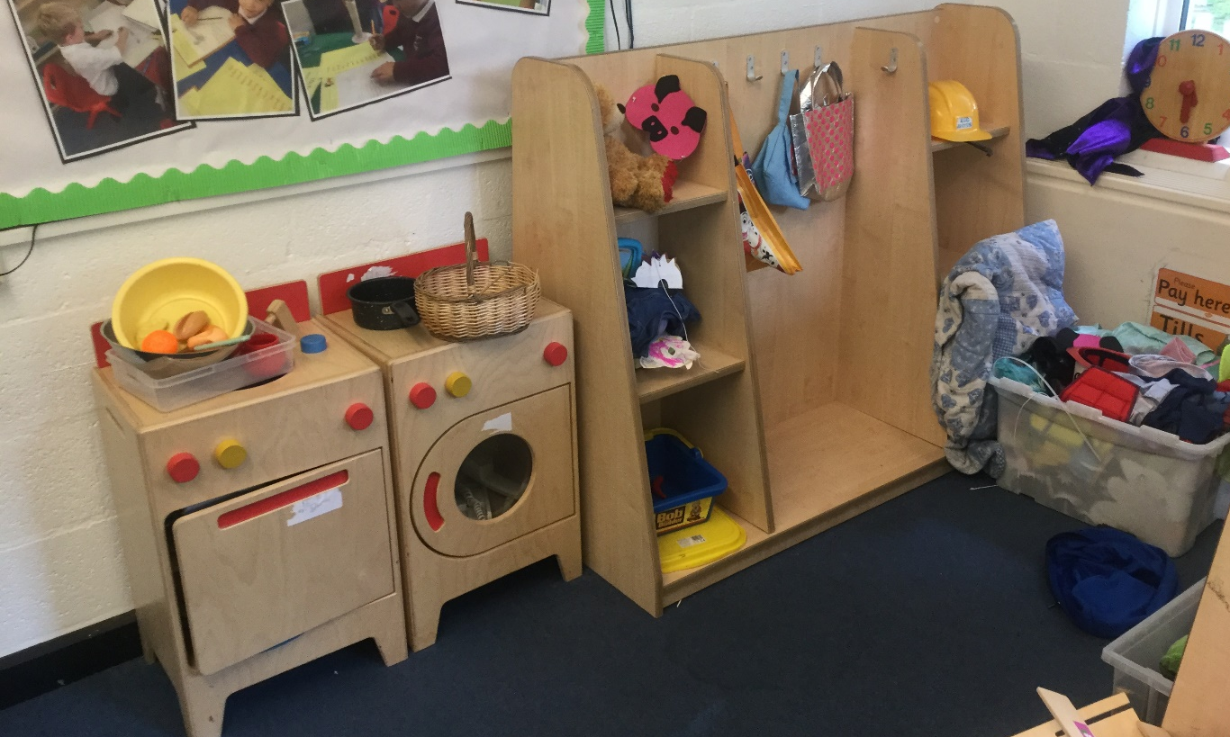
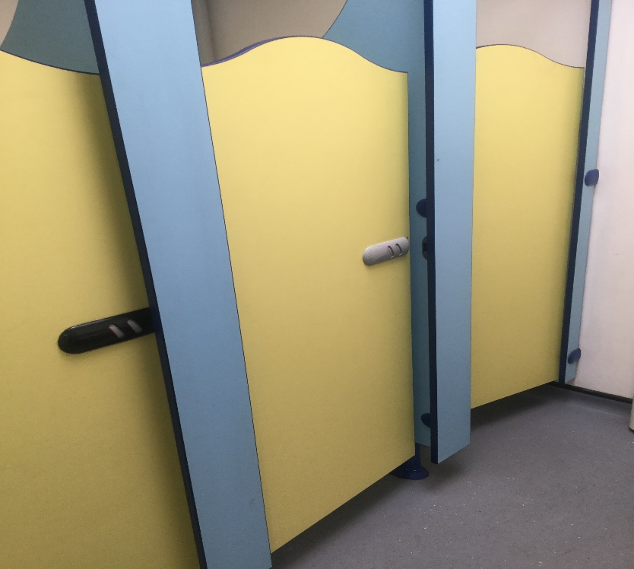
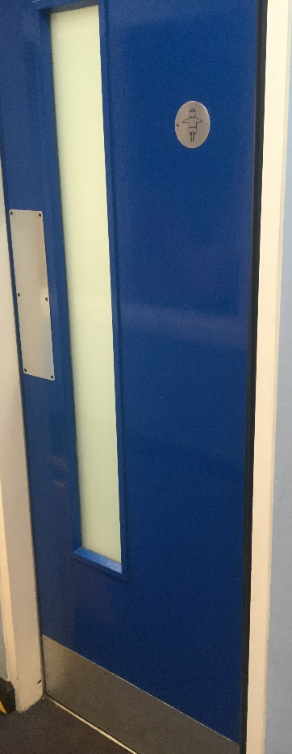
I know lots of you like pretend play and the home corner.
In reception we have a home corner and some dressing up.
These are the toilets.
When you need to go to the toilet just ask a grown up.

Slide 13
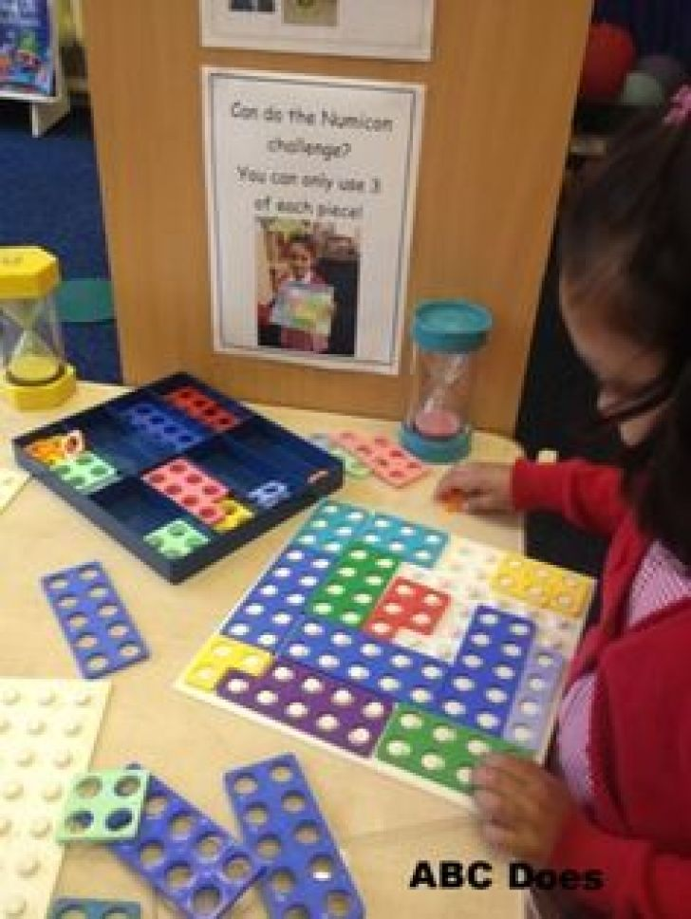
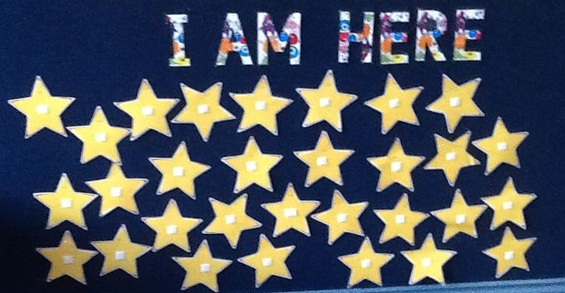
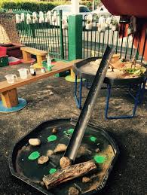
Your Day
Although each day is different in reception, there are some things that we do every day.
8.45: Gates open
8.45-8.55: Come into reception and find your name! As the year progresses, the class will complete an early morning challenge.
9.00: Carpet time. This will last for about twenty minutes.
After the carpet, the teacher will do an extension activity to support and challenge different groups of children. This will go on throughout the morning.
The rest of the children will be able to continue their learning by exploring the different activities set up inside or outside and take part in challenges.
For all those hungry tummies, there will be snack time with water or milk.
10.15: Snack and phonics to follow.

Slide 14
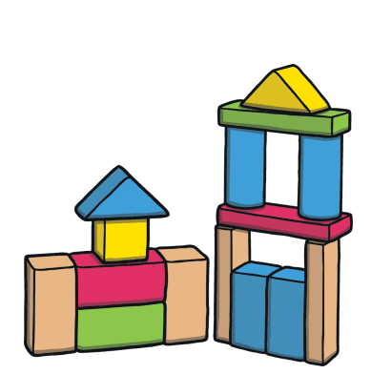
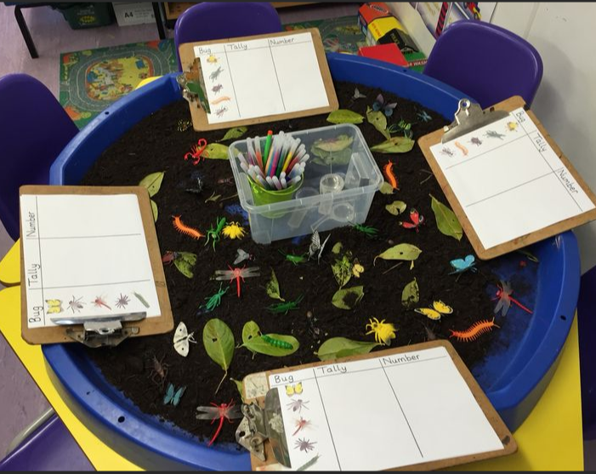
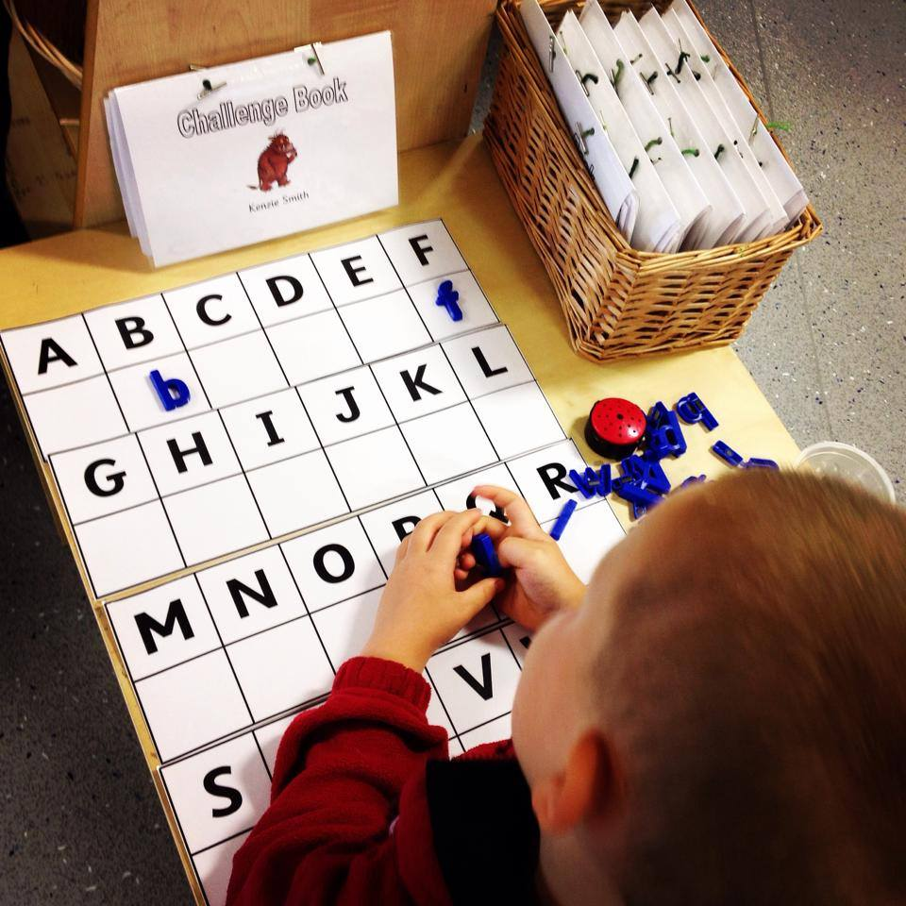
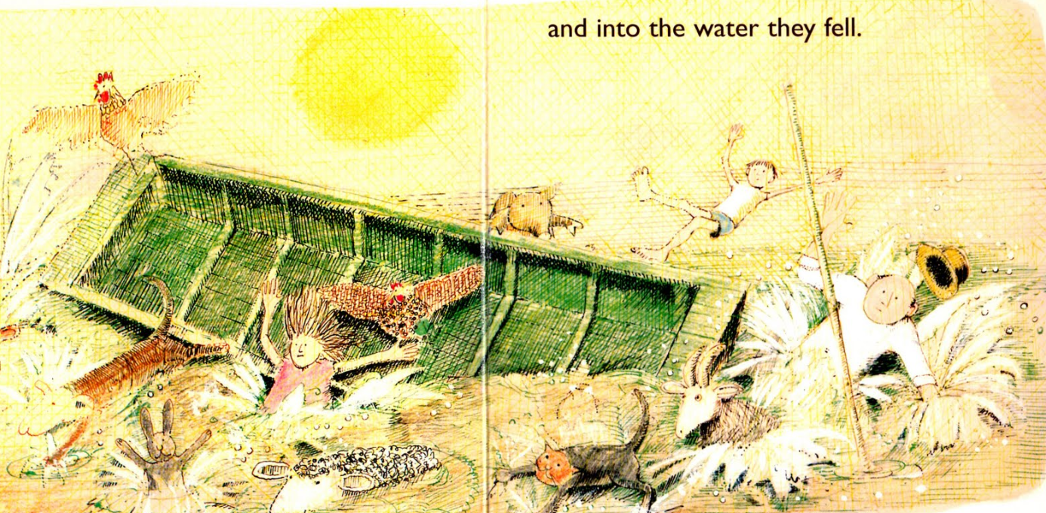
11.30: Tidy up.
11.45-12.45: Lunch time
12.45-1.15pm: Afternoon register, calm and carpet session.
This carpet session will usually have an understanding the world focus or expressive arts and design. If needed, we will have a ‘calm’ session as well including some relaxing music and yoga.
1.20pm: In the afternoon we will carry on with the small group work from earlier.
Children complete their challenges and adults will observe and interact with the children, prompting and scaffolding their learning. At first, the children are encouraged to complete the challenges. By the Spring term, they become non-negotiables.
2.30pm: Tidy up time!
2.40pm: Songs and stories. Here we will enjoy singing and reading the stories we are focusing on this week as well as reading for pleasure.
3pm: Children must collect any work from their own folders that they wish to take home and collect their coats.
3.15pm: Home time.
Throughout the day there will also be ‘incidental’ teaching in writing, reading and maths… their learning, exploring and reflecting is ongoing.

Slide 15
This is an example of a typical week in reception. The LSA may lead the small groups and these could happen inside or outside.
 | Monday | Tuesday | Wednesday | Thursday | Friday
DAILY CHALLENGES in provision | Fine Motor and gross Motor Expressive arts and design/Understanding the World Maths Literacy | Fine Motor and gross Motor Expressive arts and design/Understanding the World Maths Literacy | Fine Motor and gross Motor Expressive arts and design/Understanding the World Maths Literacy | Fine Motor and gross Motor Expressive arts and design/Understanding the World Maths Literacy | Fine Motor and gross Motor Expressive arts and design/Understanding the World Maths Literacy
9.00 – 9.20 | Whole Class Carpet Session Monday is normally the day we introduce our key text. | Carpet Time: This may be maths. | Carpet time. This may be writing. | Whole Class Carpet Session Focus: This may be maths | Whole class carpet session: Reading
9.20-10.15 | Teacher small groups: Children are able to go outside and inside. On Mondays we swap reading books. | Teacher small groups :Maths Children are able to go outside and inside. | Teacher small groups: Writing if the focus Children are able to go outside and inside. | Teacher small groups: Writing LSA Focus Writing and EAD Children are able to go outside and inside. | Teacher focus: Guided Reading in small groups. LSA: observation catch up
10.15 – 10.45 | Snack time followed by phonics. On Friday we learn ‘Tricky Words’.
10.45-11.30 | Small groups Free Flow inside & outside | Teacher Focus :Maths Free Flow inside & outside | Teacher small groups LSA Focus Maths and EAD Free Flow inside & outside | Teacher Focus: Writing LSA Focus Writing and EAD Free Flow inside & outside | Teacher focus: Guided Reading
11.30-11.45 | Tidy, maths games
11.45-12.45 | Lunchtime
12.45-1 | Meditation/yoga | Getting changed for PE | Meditation/yoga | Meditation/yoga/songs | Children’s choice
1-1.20pm | Expressive arts and design carpet | PE | Carpet time, this could be space, shape and measure | Understanding the world | Philosophy for Children/PSED
1.30 – 2.30 | Free Flow inside & outside Teacher Focus: observations and LJ reflections LSA: Small group interventions (to start in Spring) | PE Home Learning Celebrations | Teacher Focus Reading one to one with each child LSA: observations and LJ reflections | Free Flow inside & outside Teacher Focus: Writing LSA Focus Writing and EAD | LSA: observation catch up
2.30-3.00 | Tidy up, story time and end of the day.

Slide 16
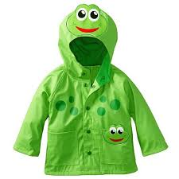
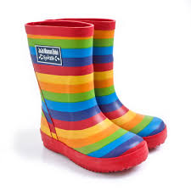
What to Bring to School…
Waterproof raincoat with a hood- no umbrellas!
Wellington boots – for wet weather and mud kitchen
Hat and gloves for cold days – we will still be outside!
P.E Kit – not at first. We will tell you when PE will start and on what day.
Book bag – a key ring is good to identify quickly
Spare knickers/pants/socks/tights in a plastic bag in book bag – there will be accidents
Sun cream/sun hat for summer months/hot days. No sunglasses please.
Water bottle (milk provided until they are 5)
You may need to bring in a small, healthy snack for children in September. This will be confirmed.
Everything with your child’s name, including shoes and socks. Show your child where their name is so they can easily identify their things. It’s amazing what goes missing sometimes at school.

Slide 17
Activities for you
We have set a Summer Challenge for children to “have a go” at trying over the Summer Holidays. If this could be brought in for September that would be great.
We have also set up a “BOOK CLUB” a list of our favourite books for you to share over the summer (lots of them are also about starting school)!
When you come in for your tour of the classroom on the 6,7,8th of September please bring some photographs of your family/pets so we can create a Family Display in our classroom
The activities will be given out at the Storytelling Sessions next week – if you can`t make it then you may collect from the school office from Friday 2nd July

Slide 18
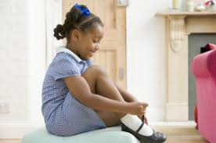
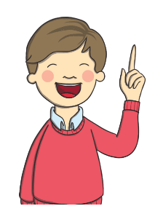
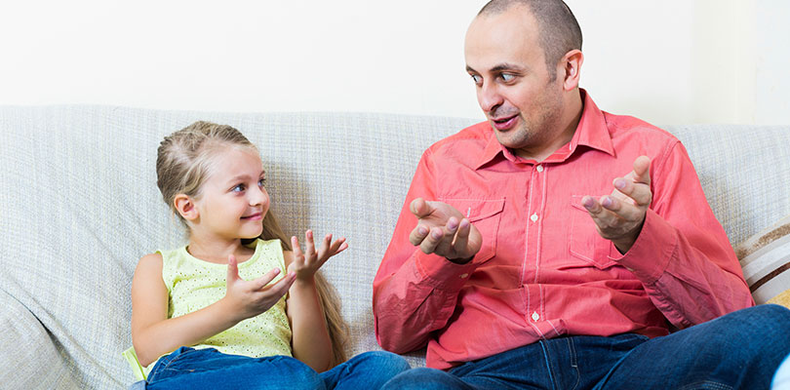
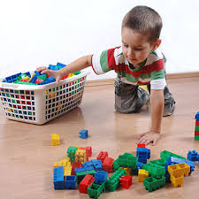
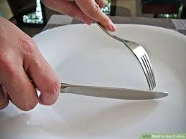
Get excited for school!
Order the school uniform before August.
What to do Now….
Encourage your child to get ready by themselves and manage their own toileting.
Take on and off their own clothes and shoes.
Practice with zips and what to do when clothes are the wrong way round.
Praise INDEPENDENCE
Practice tidying away toys each day.
This is a great time to practice counting!
When playing with your child, practice taking turns to listen to each other, speak and play.
This can be very tricky skill to
master and takes time.
Make sure your child can recognise their own name in a variety of contexts.
Encourage your child to write their own name holding a pencil correctly.
Encourage children to use a knife and fork at meal times and pour their own drink.

Slide 19
We hope to see you next Wednesday for our Storytelling Session

